Slide 1

PowerPoint Series on Geography of China (3) – Climate of our country
Personal, Social and Humanities Education Section
Curriculum Development Institute, Education Bureau
Teacher Version

Slide 2

Notes to Teachers – The learning & teaching of the climate of China and its linkages with the Geography curricula
Junior Secondary Geography:
Before teaching the modules "Changing Climate, Changing Environments" and "The Trouble of Water-Too much and too little“ in the Geography Curriculum Guide (Secondary 1-3) (2011), teachers should first teach this PowerPoint, so that students can have a basic understanding of the climate of our country.
Note: Teachers only need to teach junior secondary geography students P.5-18 of this PowerPoint.

Slide 3
In addition, teachers may consider teaching this PowerPoint first when teaching the following modules in the S1-3 Geography Curriculum, because knowledge of climate of our country can help students understand the contents of the following modules:
“Food Problem — Can we feed ourselves?”
“Population Problems — Just about numbers?”
“Taming the Sand — A long-lasting combat against desertification and sandstorms”

Slide 4
2) Senior Secondary Geography:
Teachers should teach this PowerPoint before teaching the module – “Weather and Climate” in the Geography Curriculum and Assessment Guide (Secondary 4-6) (2017), so that students can have a basic understanding on the climate of our country.
Note: Teachers should teach senior secondary geography students all contents in this PowerPoint (i.e. P.5-30).

Slide 5
Major climatic types and their distribution in our country
Climatic types are usually classified according to different combinations of heat (temperature) and precipitation.
There are 5 major climatic types in our country:
1) Temperate monsoon climate
2) Temperate continental climate
3) Subtropical monsoon climate
4) Tropical monsoon climate
5) Mountain (highland) climate

Slide 6
Major climatic types (& characteristics) | Major distribution
1) Temperate monsoon climate (High temperature & abundant precipitation in summer and cold & dry in winter, with 4 distinctive seasons) | Mainly in regions in eastern part of our country, lying north of the Qinling Mountains and Huai River and east of the temperate semi-arid and arid regions
2) Temperate continental climate (dry and extreme continental climate with little rainfall; annual and monthly temperature ranges are the greatest among various climatic types) | In regions west of the Daxinganling, Yin, Helan, Qilian and Bayan Har mountain ranges and north of the Kunlun, Altun, Qilian and Hengduan mountain ranges

Slide 7
Major climatic types (& characteristics) | Major distribution
3) Subtropical monsoon climate (warm winter & hot summer with 4 distinctive seasons; annual precipitation generally ranges from 1,000-1,500mm, with more precipitation in summer but no significant dry season) | Mainly in regions south of the Qinling Mountains-Huaihe River demarcation in eastern part of our country and north of the tropical monsoon climate
4) Tropical monsoon climate (high temperature throughout the year; long summers & no/short winters; with 3 clearly distinctive seasons: dry, rainy & hot; scarce precipitation in winters) | Mainly located at the eastern coastal regions of the continent between 10° and 20° latitudes, e.g. Leizhou Peninsula, Hainan Island, South China Sea and the southern part of Taiwan

Slide 8
Major climatic types (& characteristics) | Major distribution
5) Mountain (highland) climate (long, dry, cold & windy winters; cool & rainy summers; with hails & ambiguous seasons; long sunshine duration & temperature decreases with increasing altitudes and latitudes; with distinctive wet & dry conditions and a lot of rainy nights) | The Qinghai-Tibetan Plateau

Slide 9
Temperature distribution
The distribution of temperature in our country is mainly affected by factors such as latitudes, topography, and land & sea.
In the eastern part of our country, the terrain is low and the influence of latitude is significant. The temperature distribution in the eastern region differs greatly from north to south. As the latitude increases from south to north, the temperature distribution decreases significantly.
In the western part of our country, the surface is undulating, and the topography affects the temperature more prominently.

Slide 10
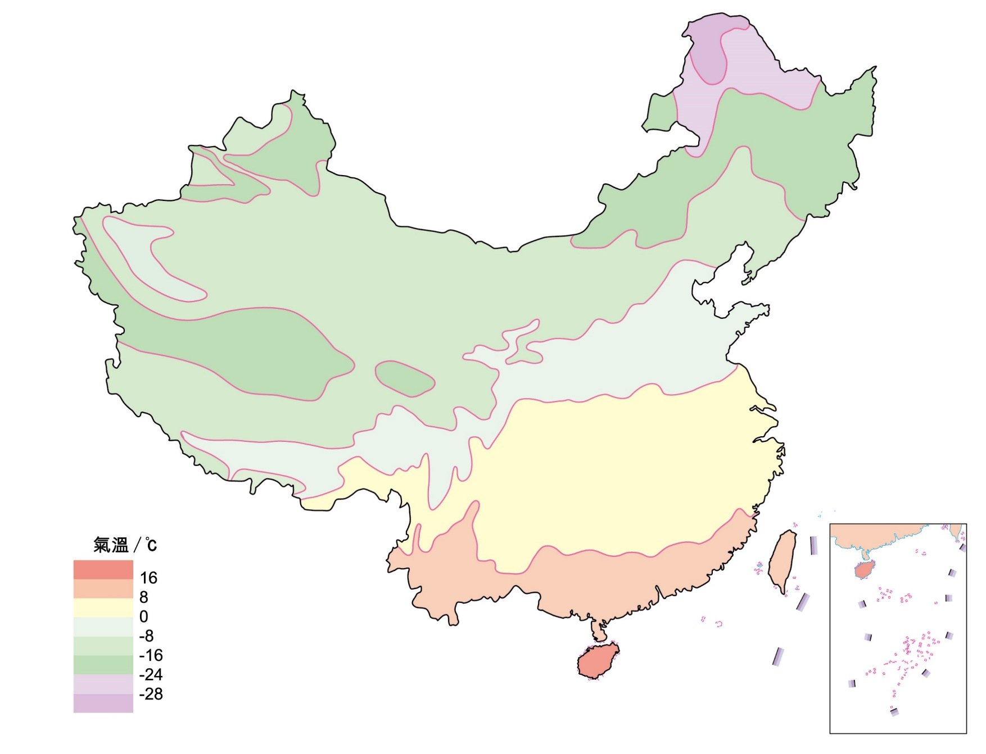

According to Figures 1 and 2, teachers may ask students to describe and compare the distribution of mean temperatures in January and July in our country
Temperature (ºC)
*No data for Nan Hai Islands
Figure 1 The distribution of mean January temperatures in our country
(Source: National Meteorological Information Center)

Slide 11
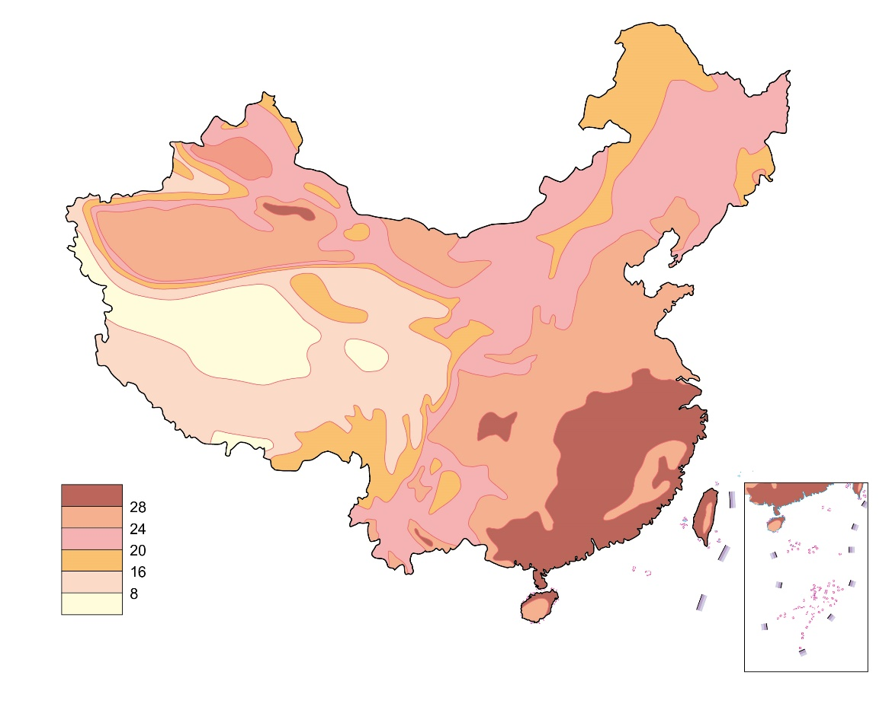
Temperature (ºC)
*No data for Nan Hai Islands
Figure 2 The distribution of mean July temperatures in our country
(Source: National Meteorological Information Center)

Slide 12
Temperature zones
Our country's temperature zones (Figure 3) are classified according to cumulative temperature.
When the average daily temperature rises steadily above 10 ℃, most crops can grow actively, so the continuous number of days with average daily temperature ≧ 10 ℃ is called the growing period. Cumulative temperature is the sum of the temperatures by adding up all average daily temperature during the growing period.

Slide 13
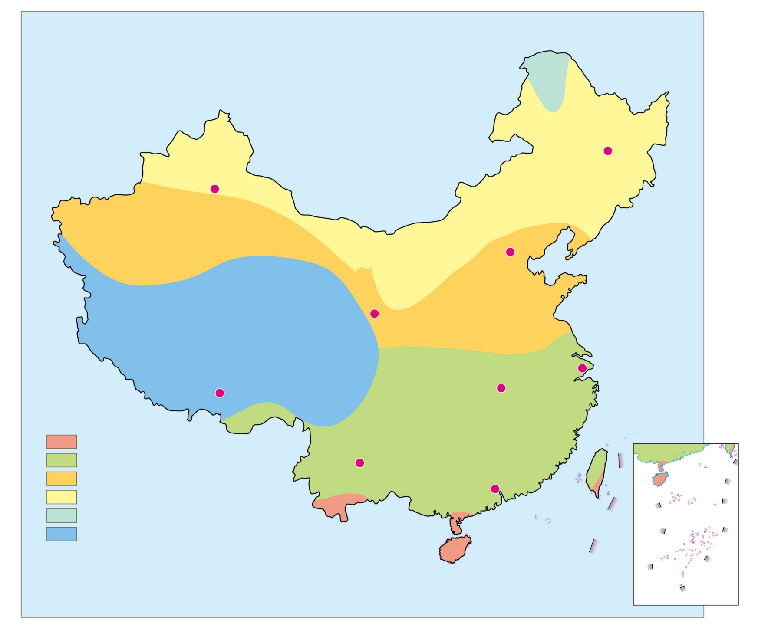
10 ℃ cumulative temperature: <1600℃
Cool Temperate Zone
10 ℃ cumulative temperature: 1600-3400℃
Harbin
Urumqi
Middle Temperate Zone
Warm Temperate Zone
10 ℃ cumulative temperature: 3400-4500℃
Beijing
10 ℃ cumulative temperature: <2000℃ (in most areas)
Lanzhou
High Plateau Climate Zone
Warm Temperate Zone
Lhasa
Wuhan
Shanghai
10 ℃ cumulative temperature: 4500-8000℃
Key
Tropical zone
Subtropical zone
Warm temperate zone
Middle temperate zone
Cool temperate zone
High plateau climate zone
Kunming
Guangzhou
10 ℃ cumulative temperature: >8000℃
*No data for Nan Hai Islands
Figure 3 Major temperature zones in our country
(Source: P.108 of the book “Learning the Geography of China through Reading (Part 1): The physical environment” published by the Education Bureau (Hong Kong) in 2013.)

Slide 14
Spatial distribution of precipitation
The rainy season in South China starts early and ends late, with a long period of precipitation occurring mainly from May to October, whereas the rainy season in North China starts late and ends early, with a short period of precipitation mainly in July and August.
Most places in our country have more precipitation in summer and autumn and less precipitation in winter and spring. Northeastern Taiwan is the only region in our country that is dominated by abundant rainfall in winter (winter rain type). Precipitation in winter accounts for 35% of the total annual precipitation in that region.

Slide 15
Precipitation in our country is mainly derived from the water vapour transported by the southeast monsoon from the Pacific Ocean and the southwest monsoon from the Indian Ocean.
Great differences in total annual precipitation are found in different regions of our country and in general, there is more precipitation: 1) in coastal regions than inland regions; 2) in South China than North China; 3) in mountainous areas than plains; and 4) along windward slopes than leeward ones in mountainous regions.

Slide 16
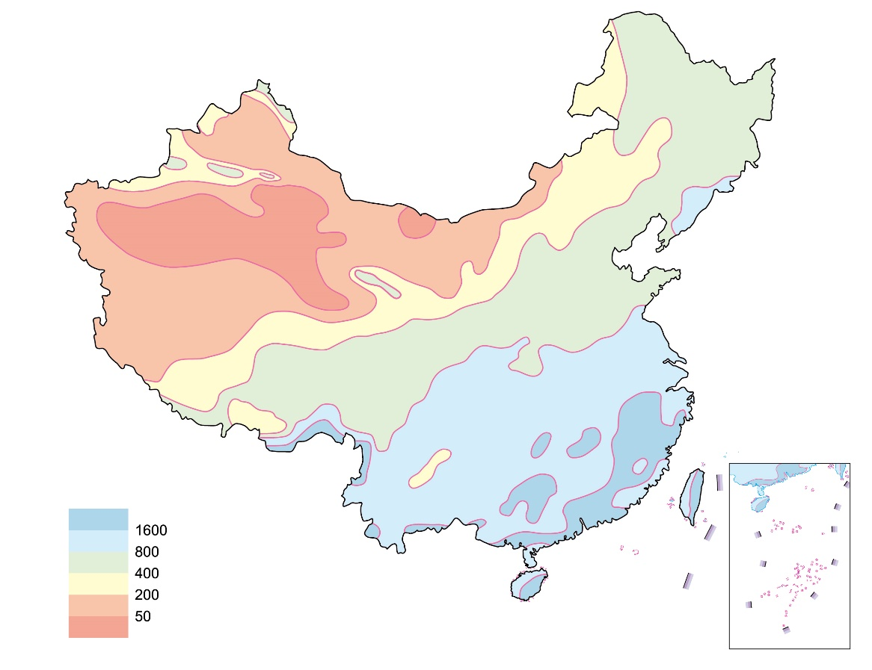
Annual precipitation (mm)
*No data for Nan Hai Islands
Figure 4 Spatial distribution of annual precipitation in our country

Slide 17
Distribution of major wet and dry regions
The degree of dryness and wetness of a location is mainly determined by the contrast between precipitation and evaporation of that location.
There is a huge difference in wet and dry conditions across our country but in general, four wet and dry regions can be distinguished: 1) humid, 2) semi-humid, 3) semi-arid and 4) arid.
Generally speaking, the humid and semi-humid regions in our country have higher precipitation than evaporation; while in semi-arid and arid regions, precipitation is lower than evaporation.

Slide 18
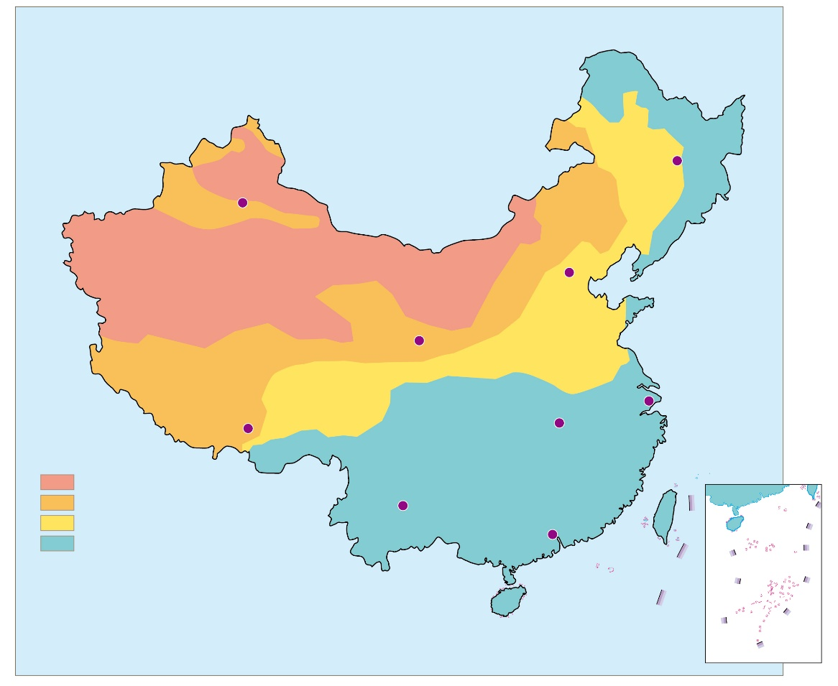

According to Figure 5, teachers may ask students to describe the distribution of the major dry and wet regions in our country
Harbin
Urumqi
Annual precipitation<200mm
Beijing
Lanzhou
Annual precipitation>400mm
Annual precipitation<400mm
Wuhan
Shanghai
Key
Lhasa
Annual precipitation>800mm
Arid Region
Semi-arid Region
Semi-humid Region
Humid Region
Kunming
Guangzhou
*No data for Nan Hai Islands
Figure 5 Spatial distribution of wet & dry regions in our country
(Source: P.96 of the book “Learning the Geography of China through Reading (Part 1): The physical environment” published by the Education Bureau (Hong Kong) in 2013.)

Slide 19
Major climatic characteristics
Complex and diverse climate
Our country has a vast territory and spans about 50 degrees in latitudes, thus forming a variety of climatic types.
The large-scale undulating three-tier topography of our country with complicated terrain conditions further increases the complexity and variety of climatic types there.
With a nation-wide annual mean precipitation of 629mm, our country’s mean annual precipitation varies considerably across the country, with a broadly decreasing pattern from the southeast coast to the northwest inland region.

Slide 20
Similarly, the climate shifts from monsoon to temperate continental climate from southeast coastal regions to northwest inland regions of our country.
2) Significant monsoon climate
Our country is located at the southeast of the largest continent (Eurasia) and at the west of the largest ocean (Pacific Ocean) in the world. Such location is highly favourable for the formation of monsoons.
The different thermal properties of oceans and lands trigger seasonal shifts in surface pressure, and resulting in seasonal shifts in the direction of prevailing winds. This is the so-called monsoon circulation, through which a monsoon climate is generated.

Slide 21
Our country has vast areas dominated alternately by summer and winter monsoons. In summer, prevailing winds blow from the ocean to the land as southerly winds (south, southeast and southwest). In winter, the prevailing winds of most regions in our country blow from the continent to the ocean as northerly winds (north, northeast, and northwest).
The winter monsoon is generated in middle and high latitudes of inland Asia and its nature is cold and dry, resulting in low temperature and low precipitation in winter in most parts of our country.

Slide 22
The summer monsoon comes from the Pacific Ocean and the Indian Ocean, and the nature is warmer and more humid, causing high temperature and rainy periods in our country.
Because the monsoon climate has a strong continental character and has obvious influence from the continent, it is also called a continental monsoon climate.
In general, areas that are significantly affected by summer monsoon are called monsoon regions, while areas that are not or rarely affected by the summer monsoon are called non-monsoon regions. The major distribution of our country's monsoon and non-monsoon regions can be seen in Figure 6.

Slide 23
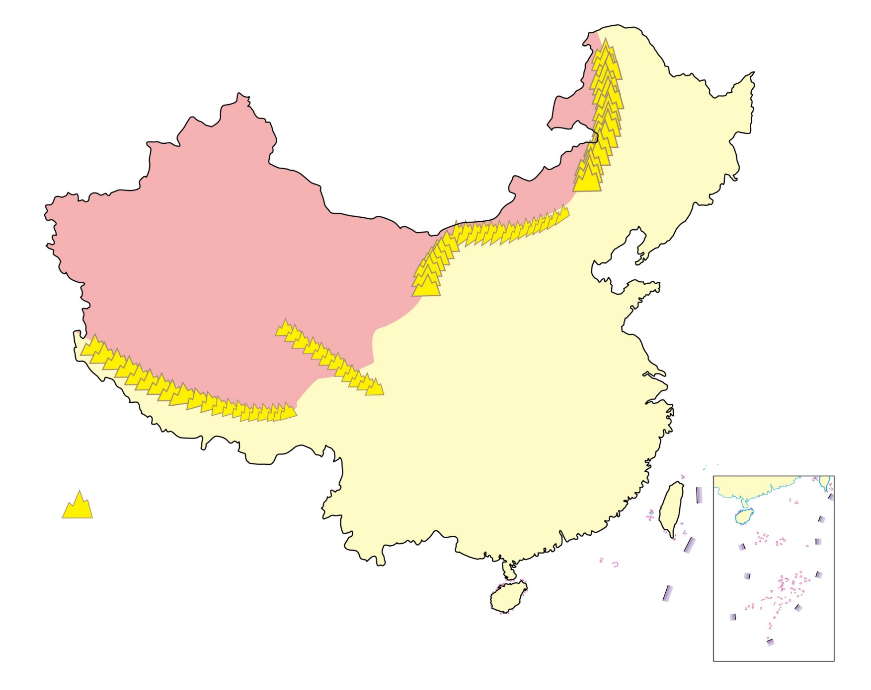
Daxing’an
Mountains
Yinshan
Mountain
Non-monsoon Region
Holan
Mountain
Bayan Har Mountain
Gangdise Mountain
Monsoon Region
Mountain Range
Figure 6 Major distribution of monsoon &
non-monsoon regions in our country
(Source: P.95 of the book “Learning the Geography of China through Reading (Part 1): The physical environment” published by the Education Bureau (Hong Kong) in 2013.)

Slide 24
Major Factors affecting
the climate of our country
Latitude:
Latitude is a basic factor affecting the climate of a location. Our Earth is a big sphere and there are different angles of incidence of solar radiation at different latitudes, with a vertical solar radiation angle at some places and an oblique angle at others (Figure 7). The duration of receiving solar radiation varies from place to place, and in some places, there will be no sunlight for the whole day or months.
Therefore, the lower the latitude, the higher the temperature; the higher the latitude, the lower the temperature

Slide 25
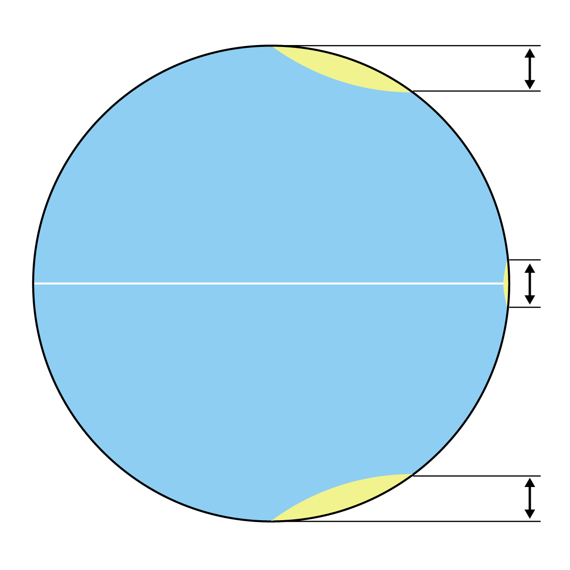
The angle & range of solar radiation at high latitudes
The Earth
The angle & range of solar radiation at equator
The angle & range of solar radiation at high latitudes
Figure 7 The influence of latitude on
solar radiation

Slide 26
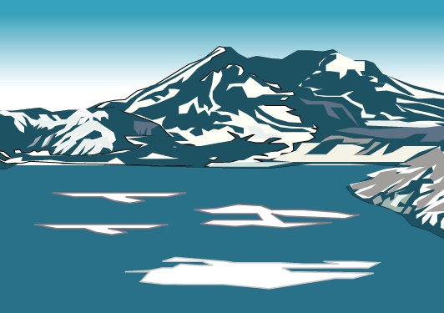
In our country, the distribution of solar radiation also decreases with increasing latitudes, but the difference between the north and the south in winter is more significant than in summer.
2) Land & Sea:
The physical properties of land and sea are different, with sea having a greater thermal capacity than land.
Therefore, under strong sunlight, the temperature of the sea/ocean increases more slowly than that of the land; after the sunlight weakens, the temperature of the sea/ocean decreases more slowly than the land.

Slide 27
In addition, the amount of water vapor in the air above the sea and the land is also different. Generally speaking, the diurnal and annual temperature changes at seas or in coastal areas are smaller and with more precipitation, resulting in a maritime climate.
Our country is located in the eastern part of the Eurasian continent and the western coast of the Pacific Ocean. Due to the outstanding differences on the thermal capacity of land and sea, a significant monsoon climate is formed, which has a profound impact on our country's climate.

Slide 28
3) Topography:
In general, a 100 m increase in altitude will lead to a drop in temperature of about 0.6℃.
[According to this relationship between temperature and altitude, teachers may ask students to complete Figure 8]
Within a certain range of altitudes, the amount of precipitation will increase as the altitude increases.
Many mountain ranges in our country with east-west orientation also acted as barriers to the exchange of cold and warm air between the north and the south, and become the dividing line(s) of climatic regions. Nanling and Qinling are examples of this.

Slide 29
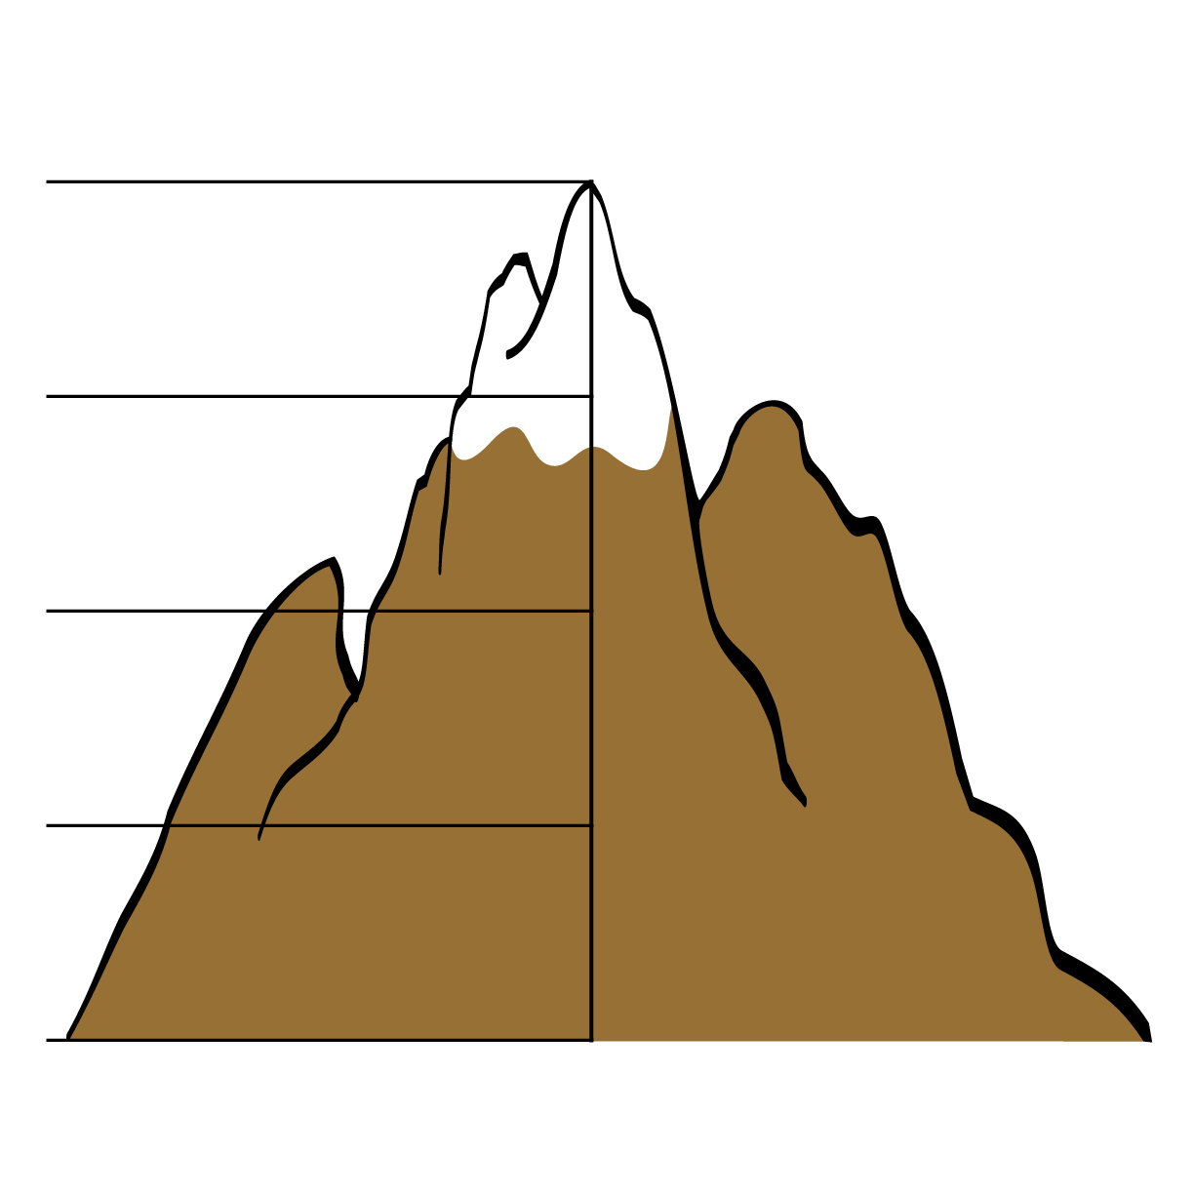
Figure 8 The relationships between air temperature & altitudes
Air temperature(℃)
Altitude (m)
4000
3000
2000
1000
18℃
0

Slide 30
The windward slopes of mountains are usually rainy and wet, while the leeward slopes are less rainy and dry.
4) Atmospheric circulation:
The atmosphere circulates regularly at global and regional scales which is often called atmospheric circulation. Atmospheric circulation transports heat and water vapor from one region to another.
For example, the cold air in Siberia and Mongolia flows to our country in winter, that is, the air flows from high latitudes to low latitudes, which can lower the temperature of most parts of our country. In summer, the warm and humid air which flows from the Pacific and Indian Oceans transports a large amount of water vapor to eastern and southwestern parts of our country causing precipitation.

